Slide 1

Creating a Custom Widget with the Web AppBuilder for ArcGIS

Slide 2
What is the Web Appbuilder for ArcGIS?
An ArcGIS Framework that allows one to create HTML/JavaScript Apps that run on desktops, tablets, and smartphones
The software allows you create applications without any coding……Even though you can create even cooler apps if you know how to code with the Developers edition
Has built in/ready-to-use widgets and themes to choose from
Allows one to deploy a WAB app on ArcGIS Online or on his/her own server
Built in responsive design (display adjust based on device accessing application)
Requires ArcGIS Online or Portal for ArcGIS
The framework is integrated with WebMaps

Slide 3
2 Options to Work With Web AppBuilder
Within ArcGIS Online or Portal for ArcGIS
Framework embedded in the web site
Activate in AGOL and Portal from Multiple places
Developer Edition
Separate download and installed locally
Sign in with ArcGIS Online or Portal for ArcGIS credentials
Support for custom widgets and themes
System requirements
https://developers.arcgis.com/web-appbuilder/guide/xt-system-requirements.htm

Slide 4

How Can It Help You Create Applications?
I will attempt to show you

Slide 5

But First…….You will need the basics (If you don’t already know them)

Slide 6
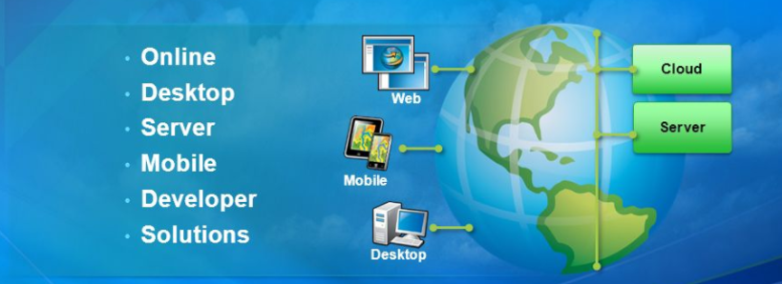
1. The Platform

Slide 7
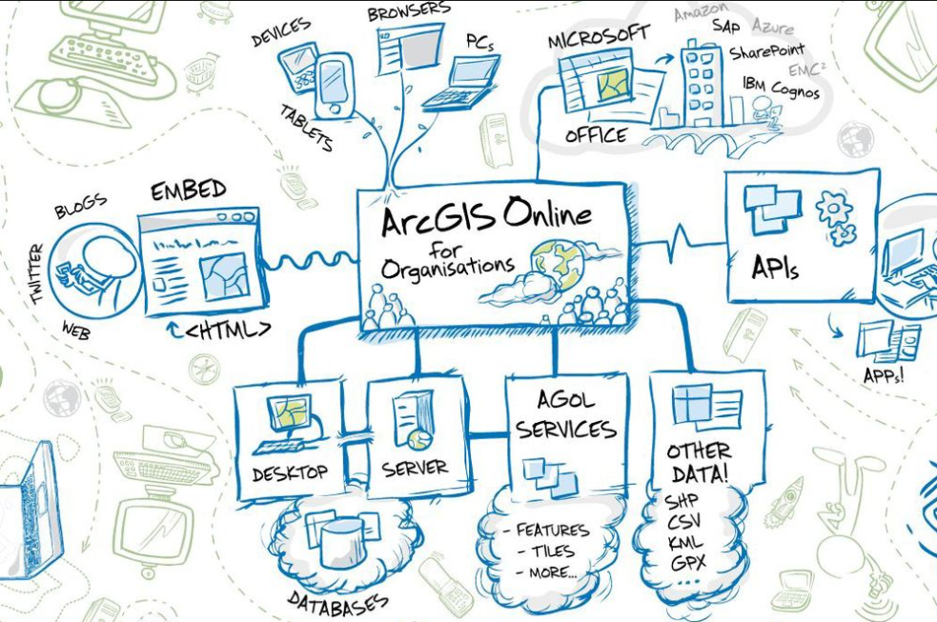
What the Platform looks like (image by Roket Science)

Slide 8
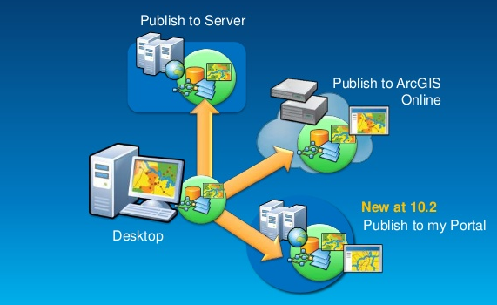
2. Publish GIS Data

Slide 9
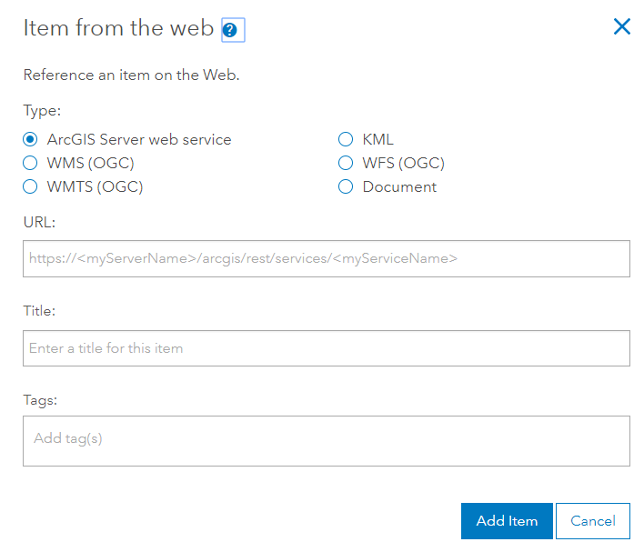
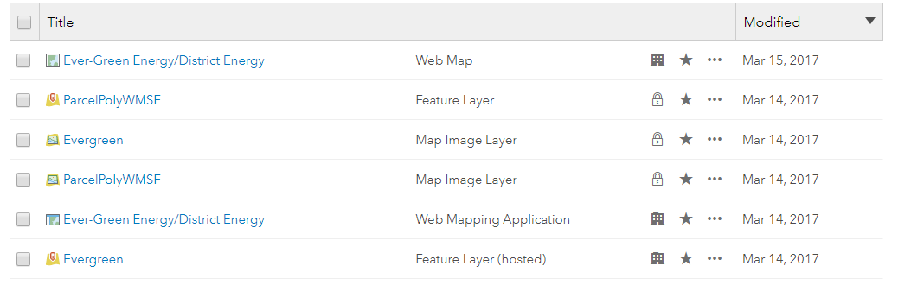
2. OR Consume services……. - hosted services (layers published to AGOL) Types: Feature layers, Tile layers, Vector tile layers, scene layers (3d), and more - consumed services - services that are stored in a ArcGIS for Server REST directory or other compatible directory that are accessed by AGOL or Portal and stored in a config file

Slide 10
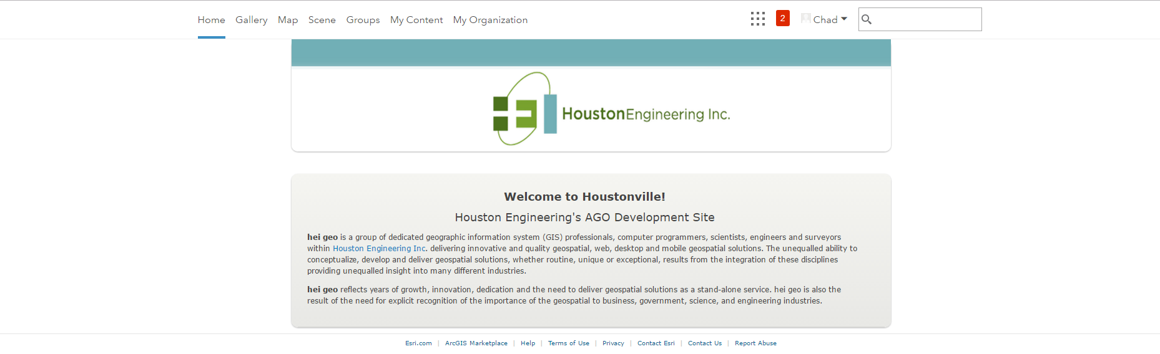
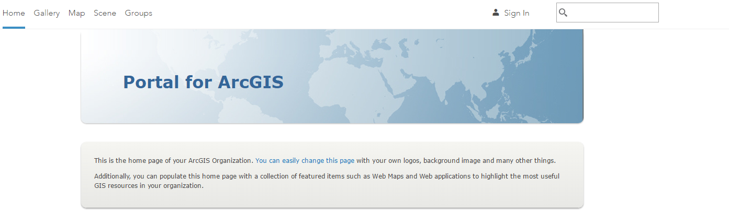
3. Create a web Map – Portal or ArcGIS Online

Slide 11
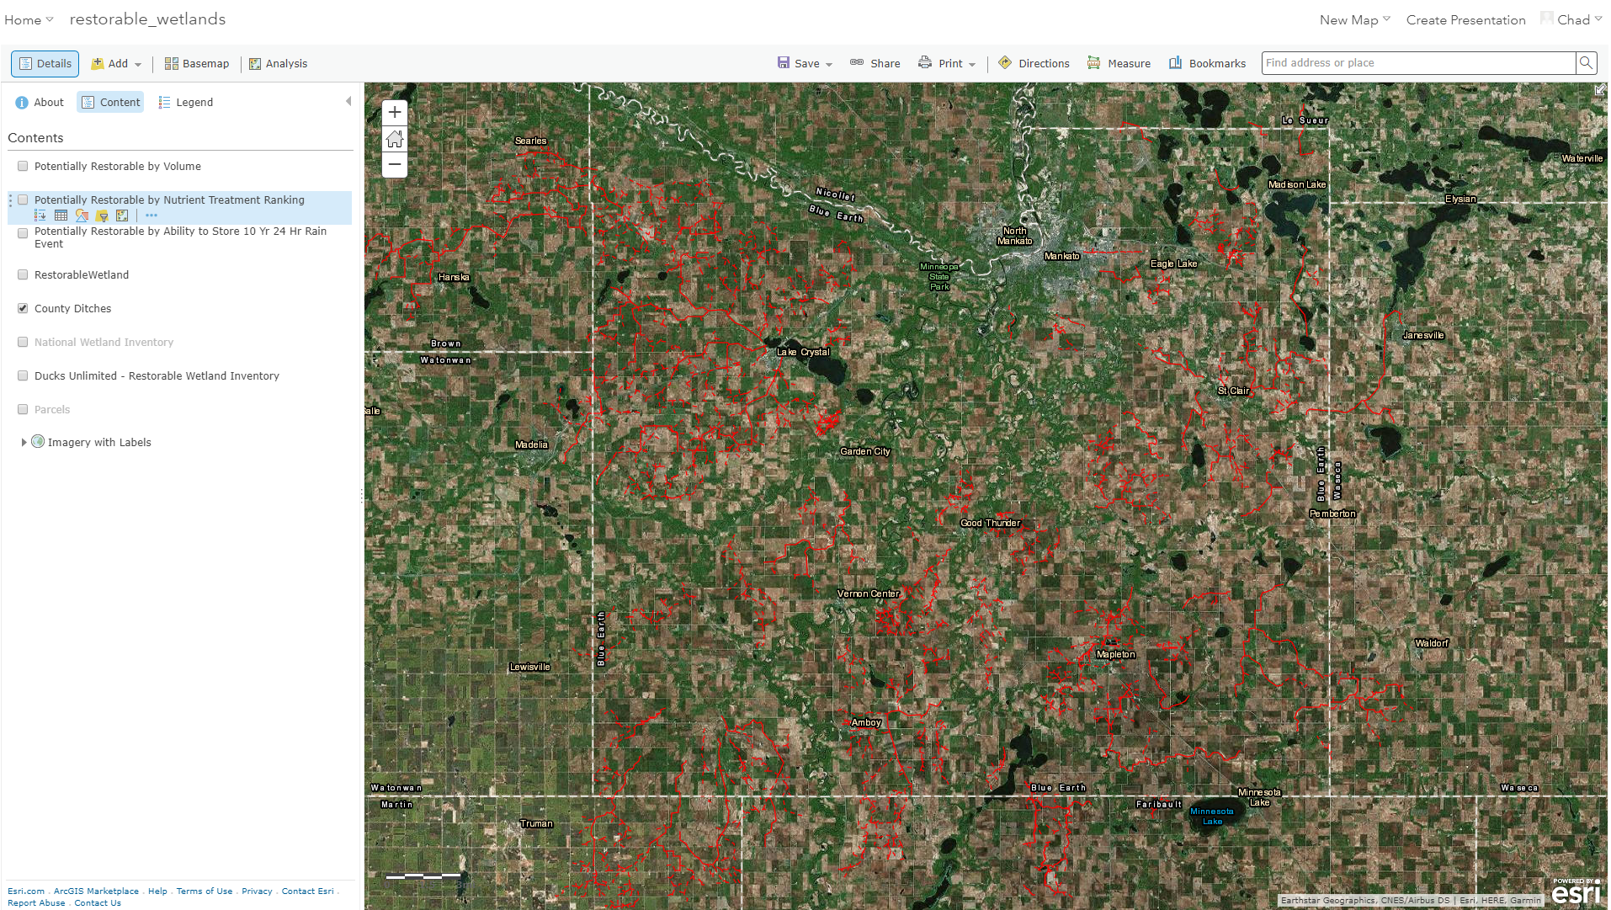
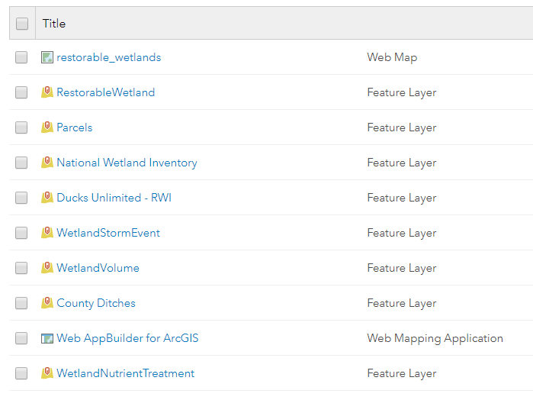
4. Configure, Share, and Save the web map

Slide 12
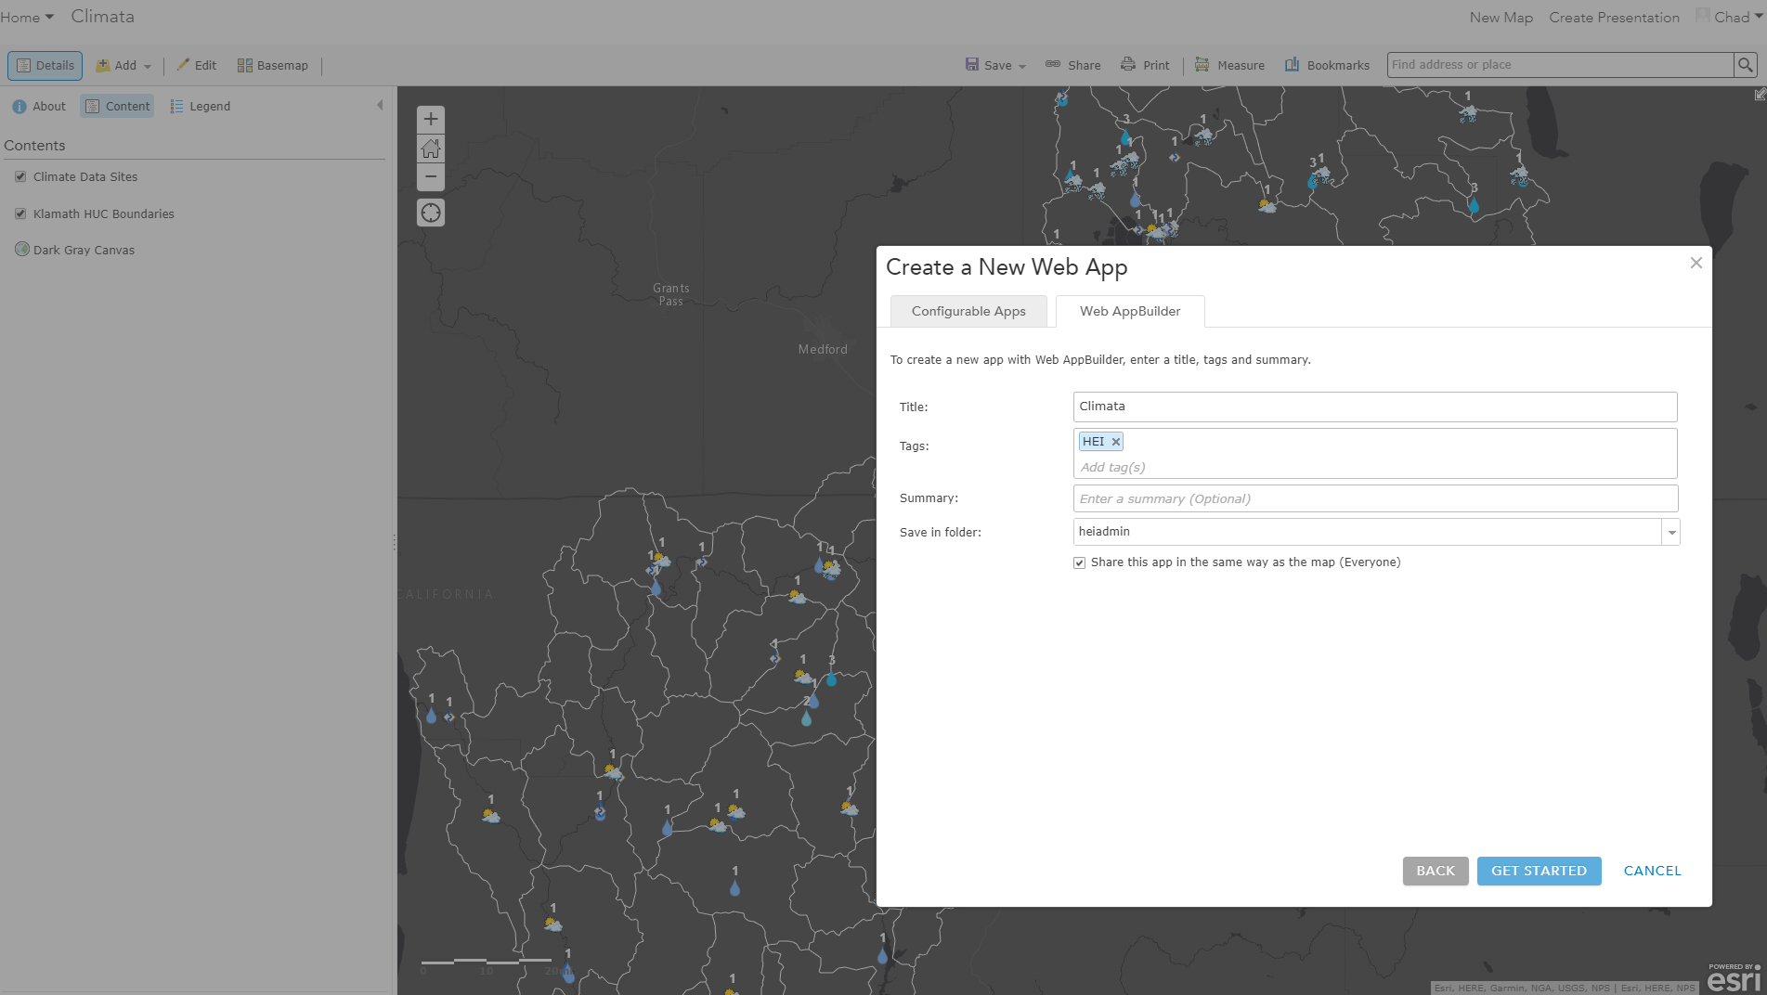
5.(Optional)Create a Web AppBuilder App from your web map in Portal for ArcGIS or ArcGIS Online – Same Process!

Slide 13
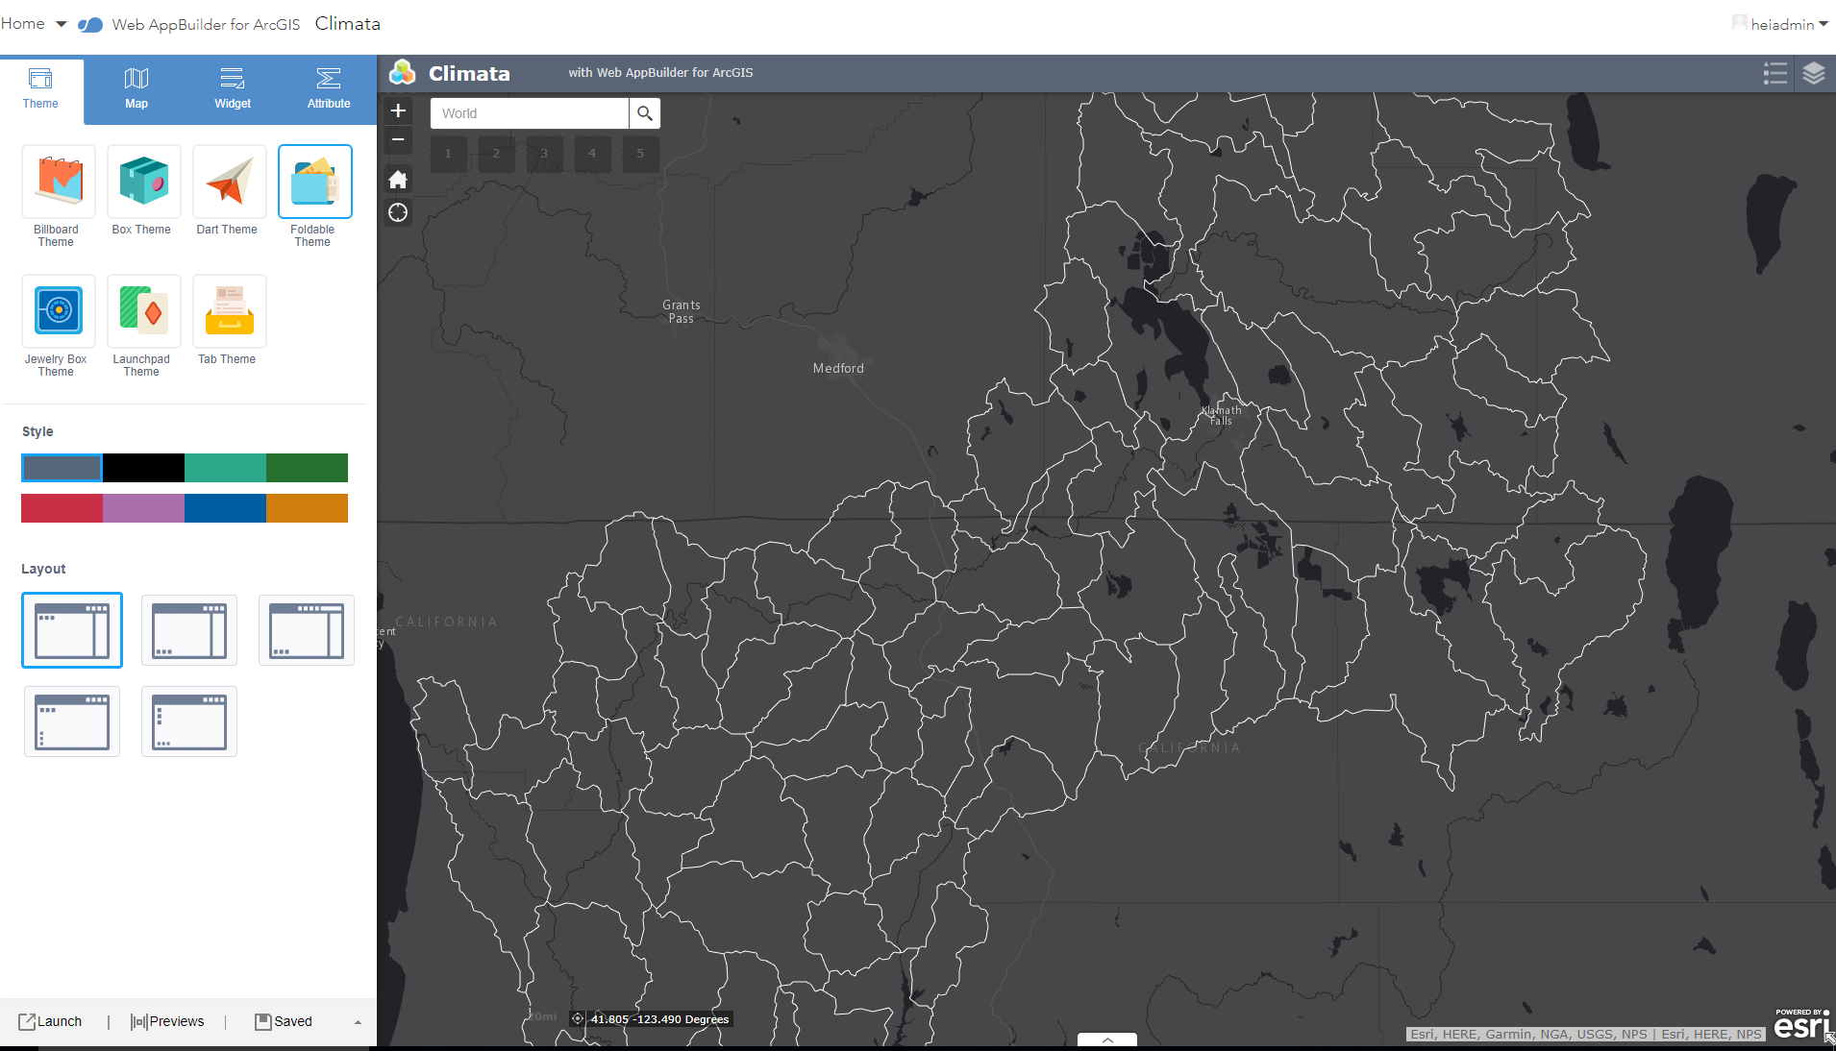
6. Configure your app. Pick a theme and all out-of-the-box widget you want. Save Note: The step can also be done in the WAB Developer Version

Slide 14
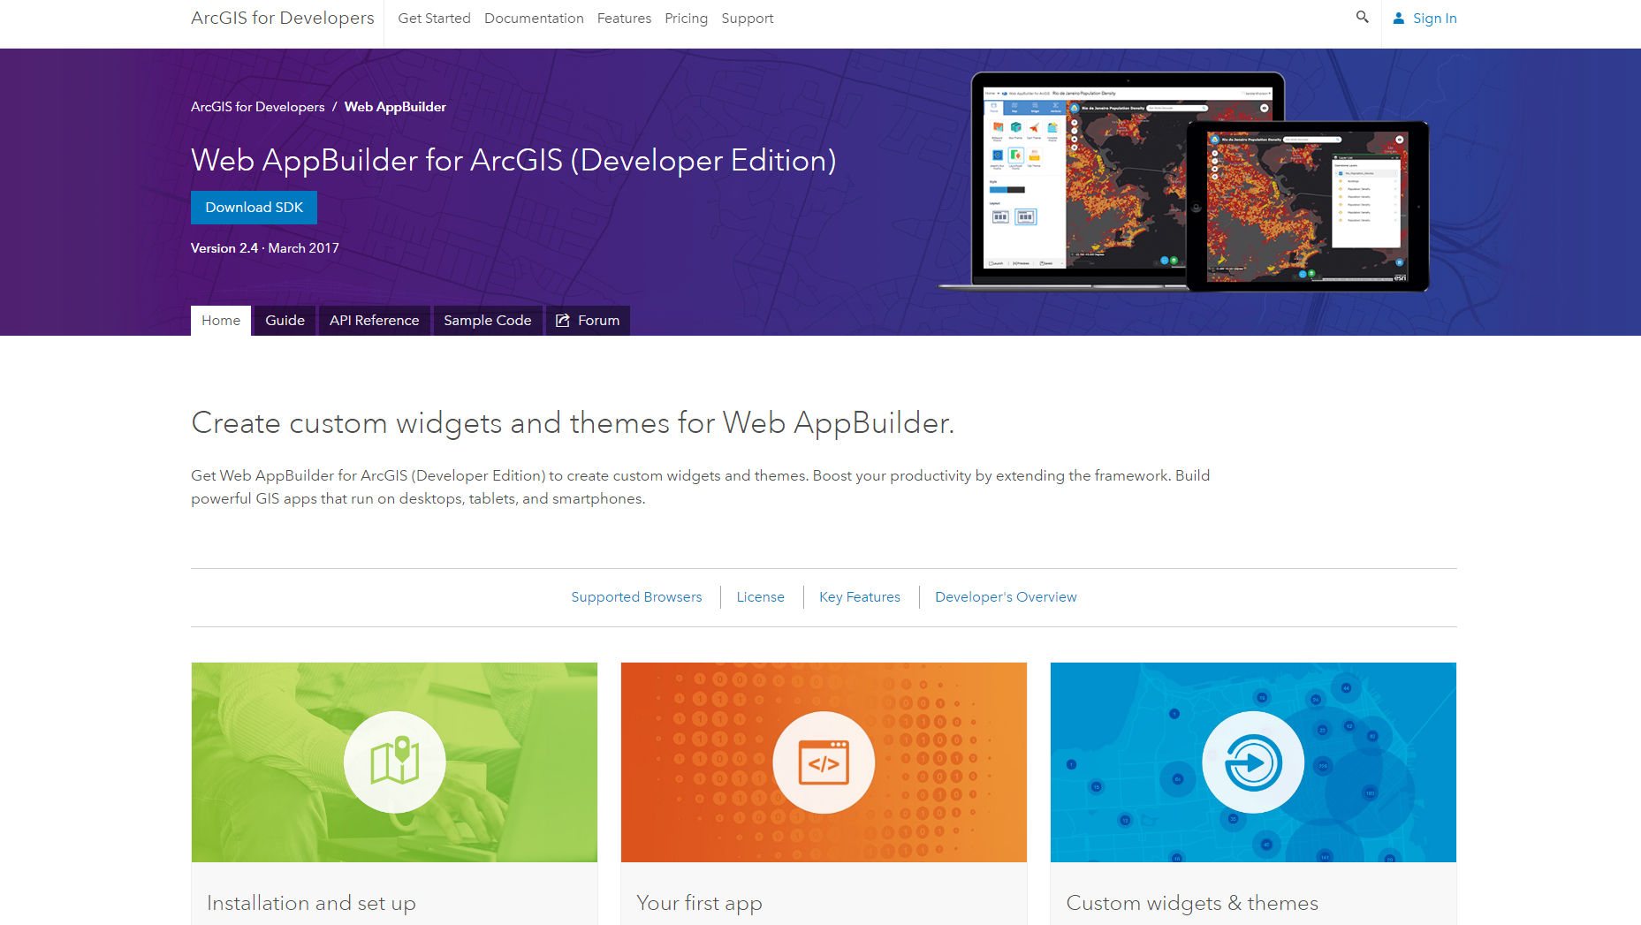
Getting Ready to Roll with the Developers Versions of the WAB……Download the Software

Slide 15
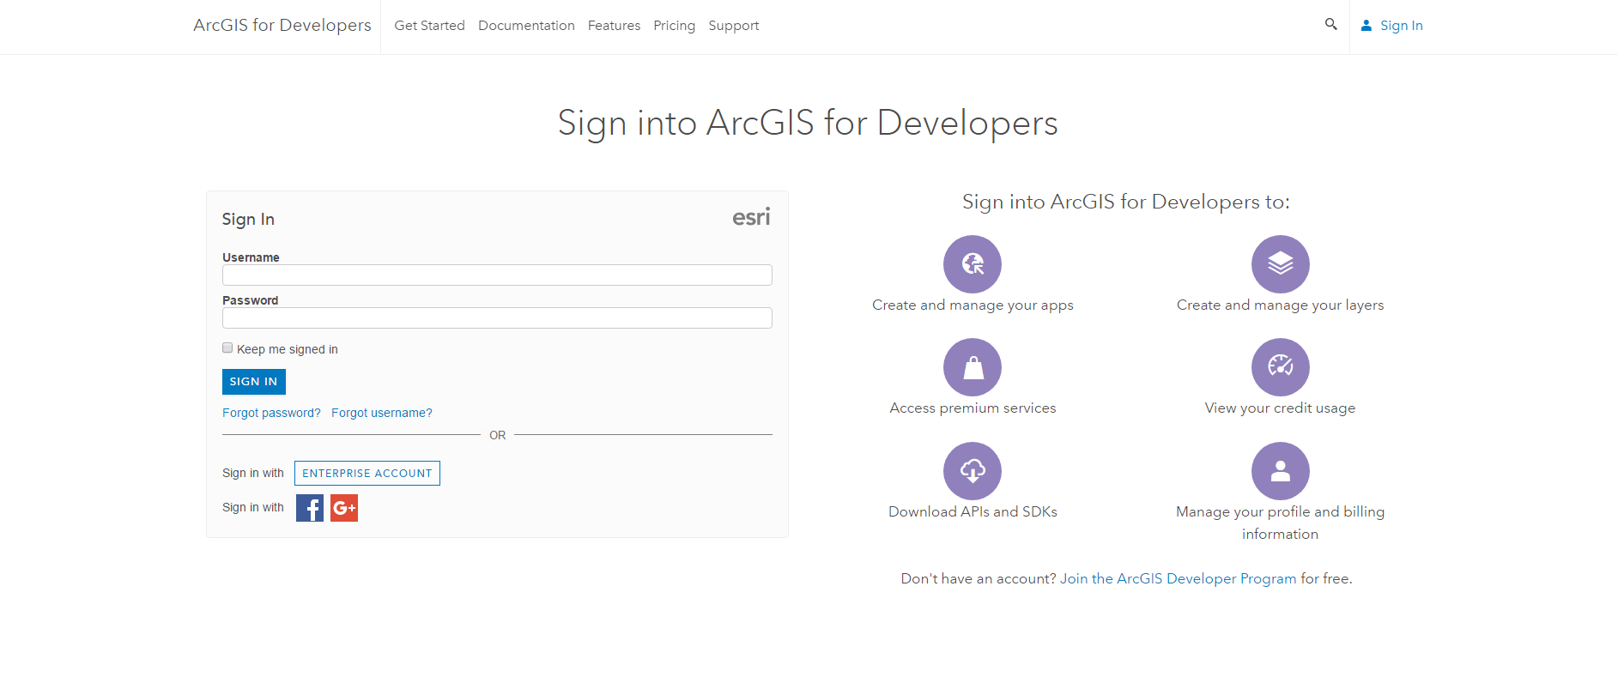
Sign In before you Download

Slide 16
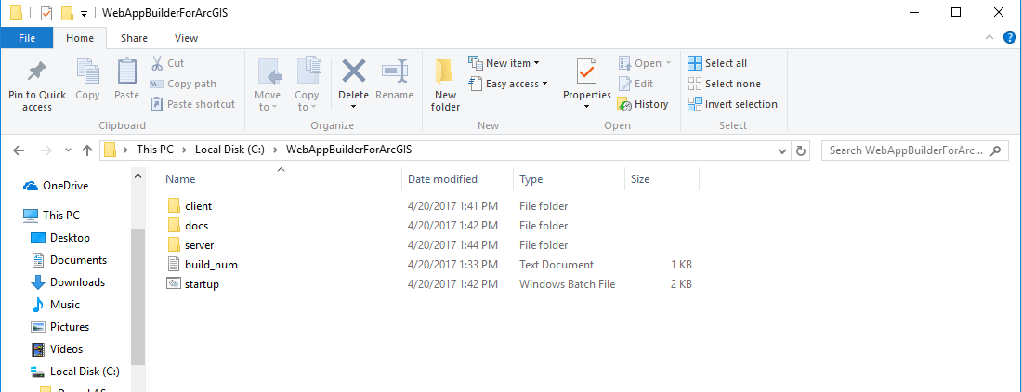
Extract Downloaded Zipfile to Desired Location

Slide 17
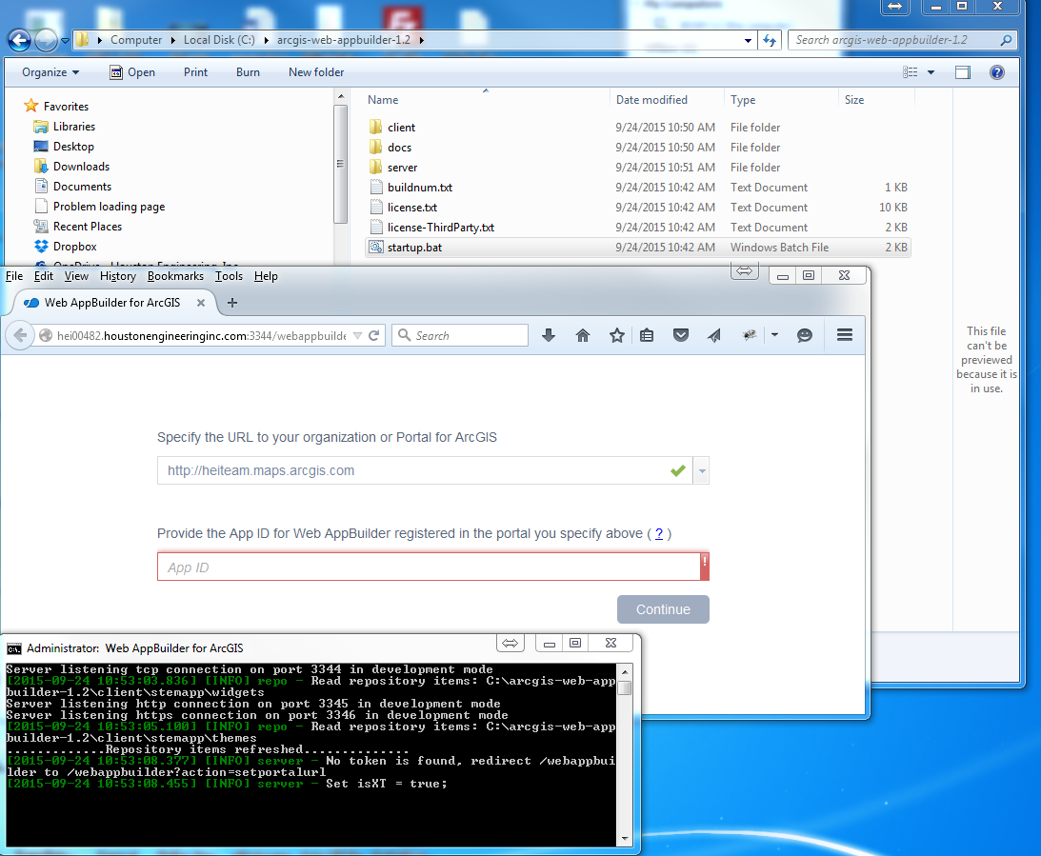
Configure Software….Just a Couple Items

Slide 18
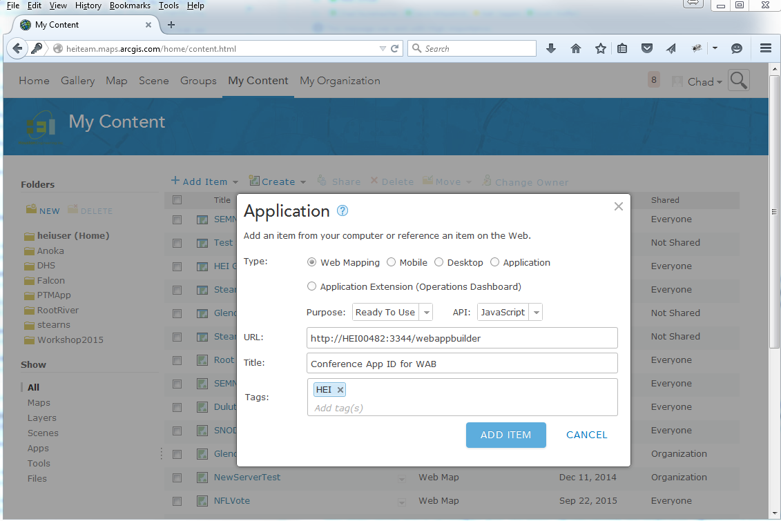
Create Application in AGOL or Portal

Slide 19
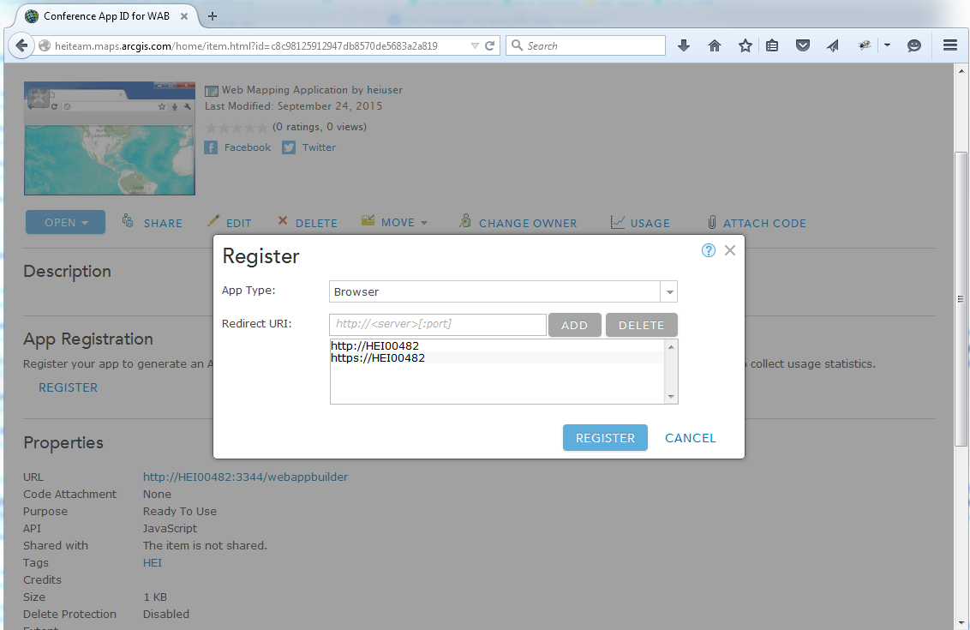
Register Application

Slide 20
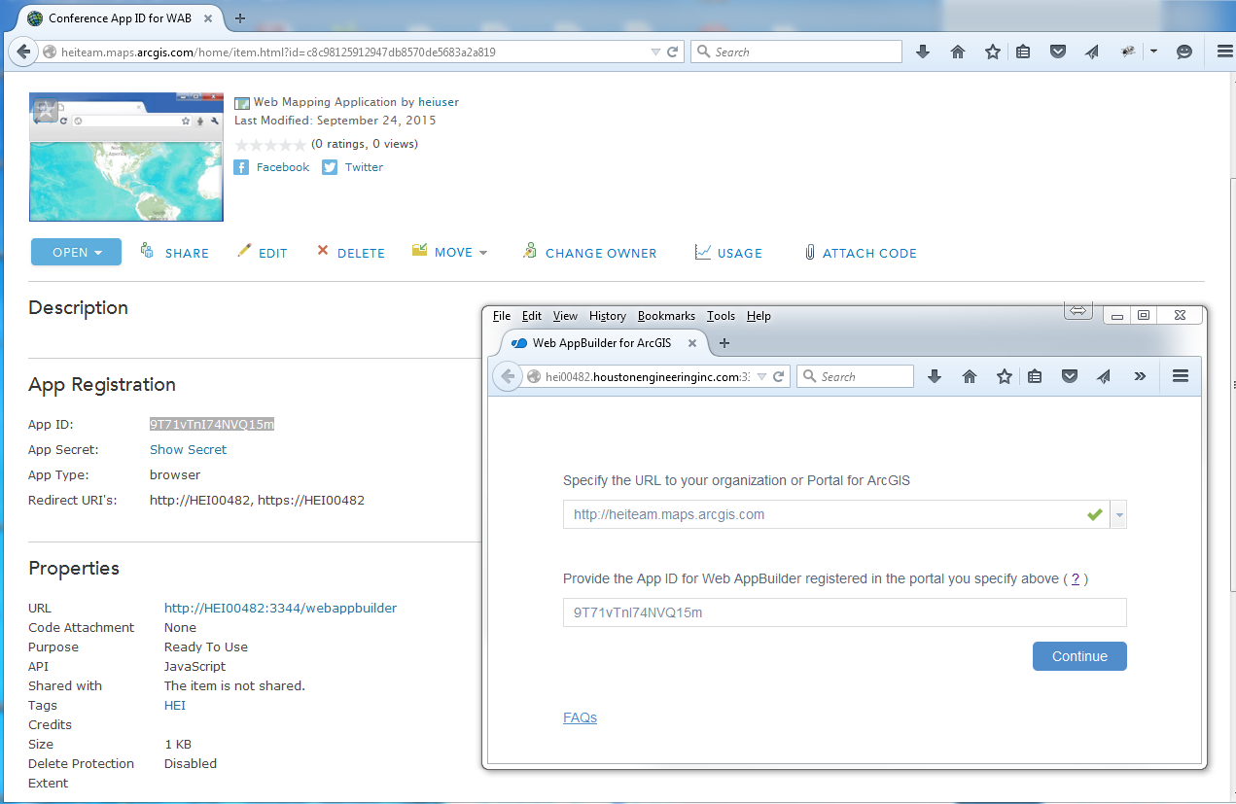
Add AP ID (and Portal URL) to WAB

Slide 21

Invalid Redirect_URI message……WT????????....No Worries….Not a Big Deal

Slide 22
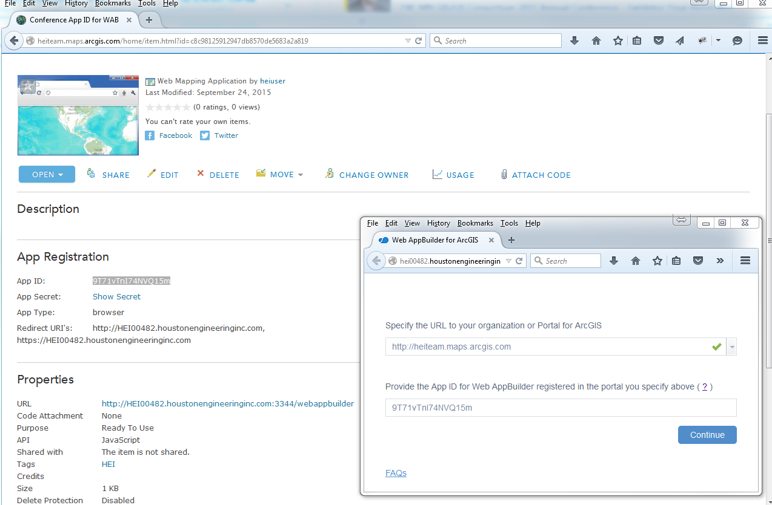
Figure Out Why….In My Case, the full computer name wasn’t used the first go-round. Update App Registration, delete singininfo.json, and try again

Slide 23
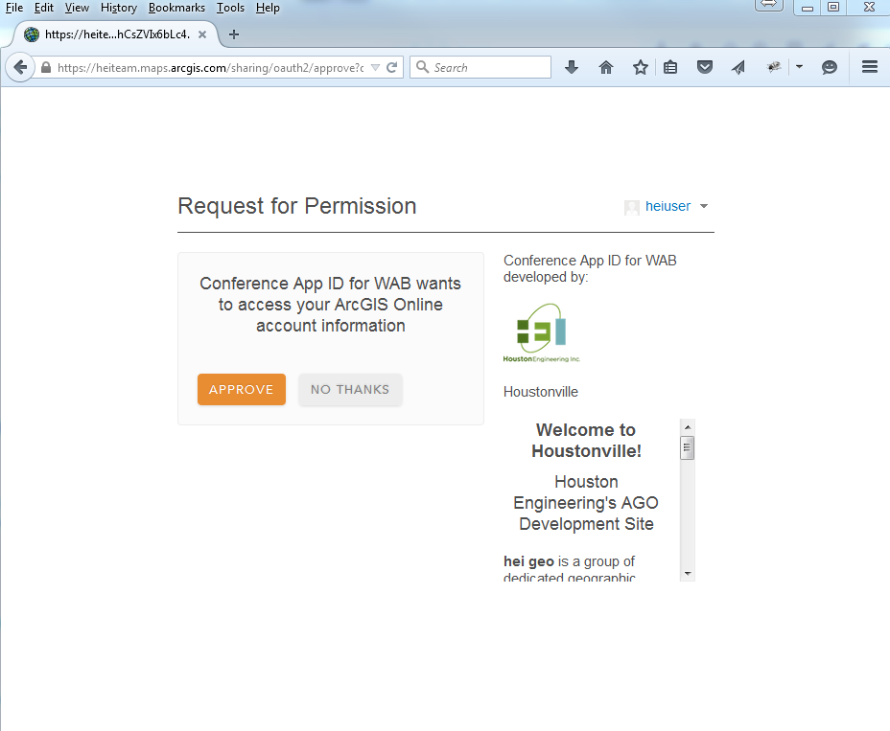
New AppId Worked!!!....Now just give permission

Slide 24
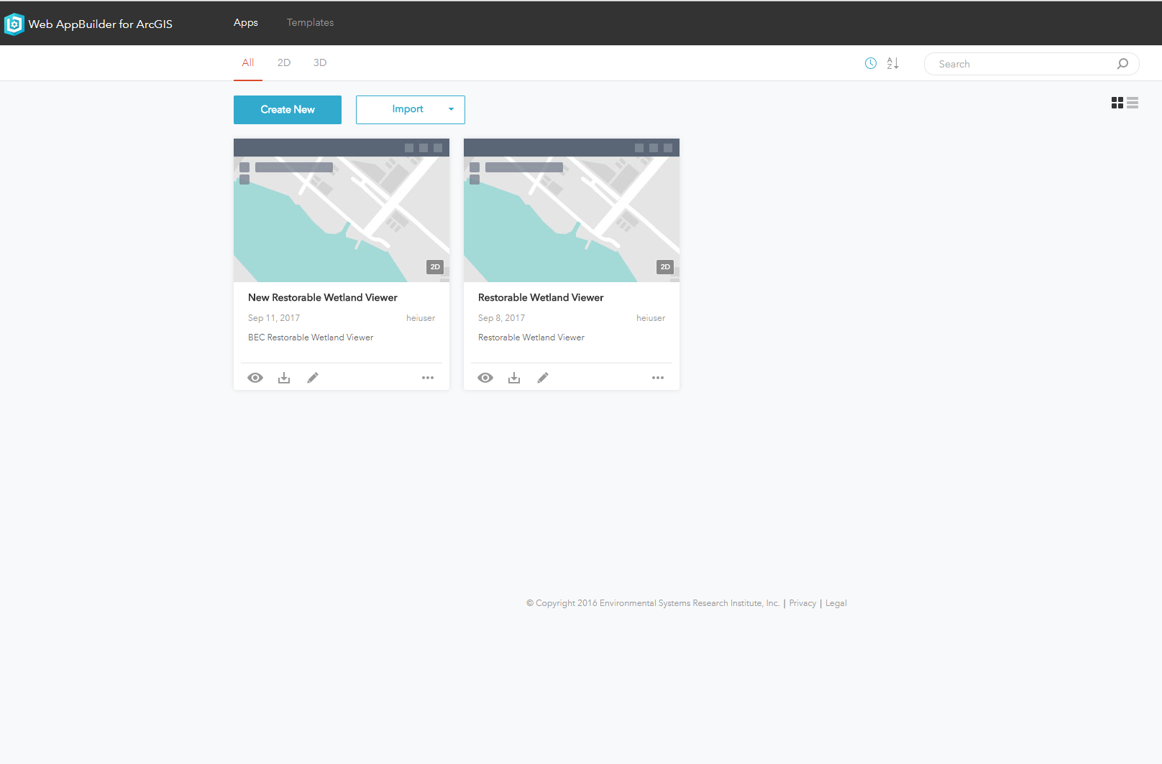
Create New OR Import (Account or Computer)

Slide 25
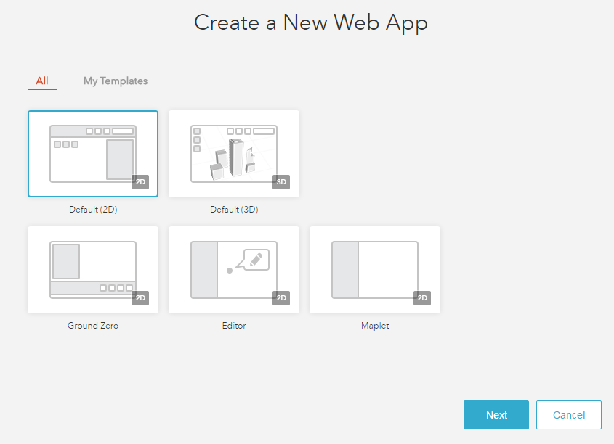
Create New - Select Template

Slide 26
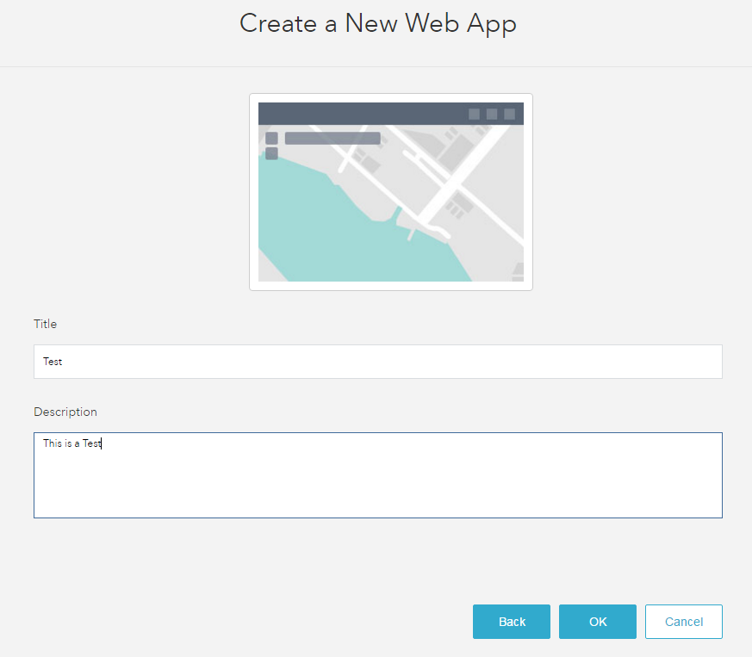
Create New - Give It A Name

Slide 27
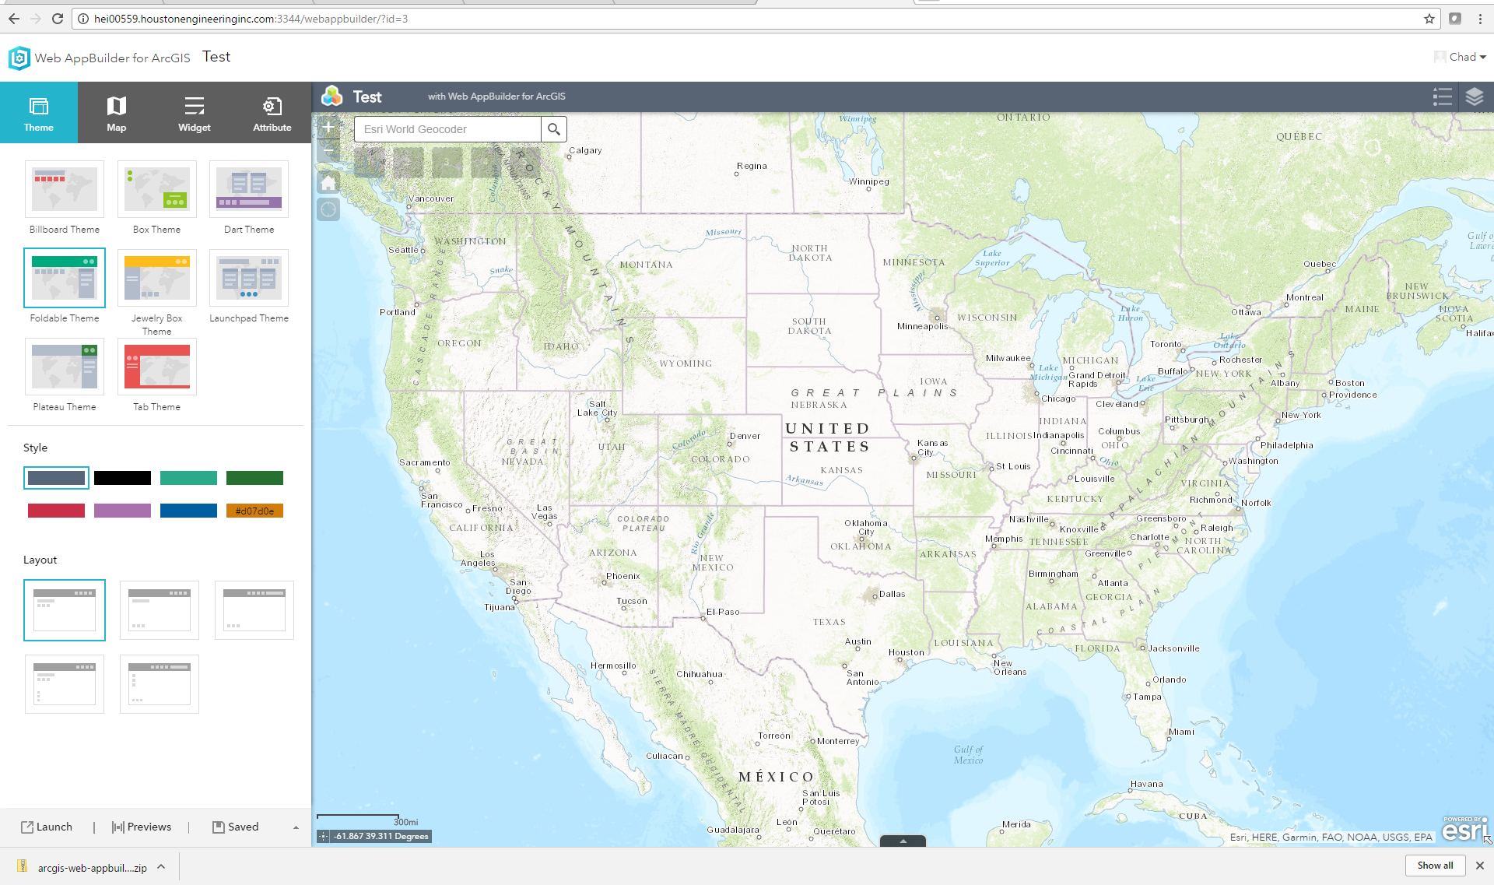
Create and/or configure application with the WAB Developer Edition (Note: Step 5 and 6 in AGOL or Portal Could have been accomplished via the Developer Edition as well)

Slide 28
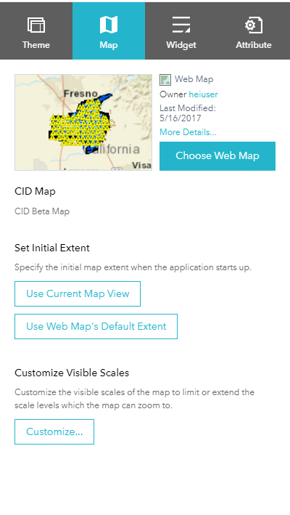
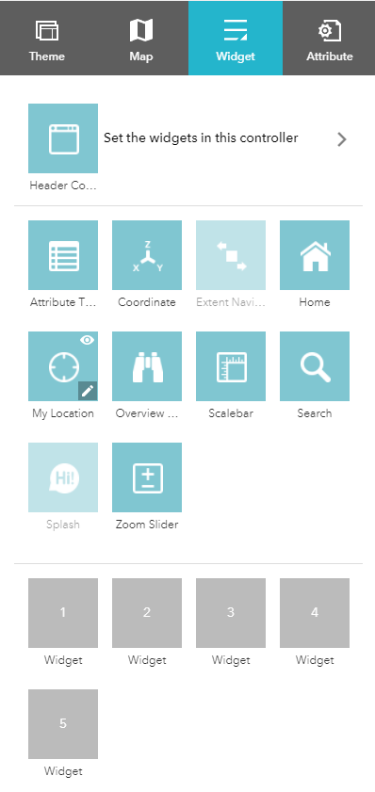
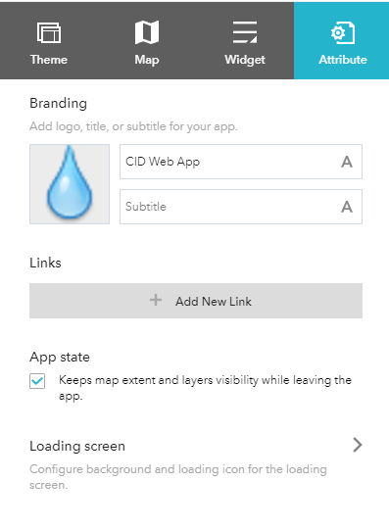
Create and/or configure application with the WAB Developer Edition (Note: Step 5 and 6 in AGOL or Portal Could have been accomplished via the Developer Edition as well)

Slide 29
Paul Takes Over

Slide 30

Now On To That Coding Stuff …

Slide 31
Developer Edition – First Steps - Review
Download Developer Edition Files
Start .BAT batch file
Register App ID
Create some new Web Map

Slide 32
Wait … What about the ArcGIS JavaScript API ???
Still exists !
For advanced site designing and customizations
Not as many restrictions
Does not require ArcGIS Online or Portal connection
Does not require Web Map and can work directly with services.
3.X vs 4.X

Slide 33

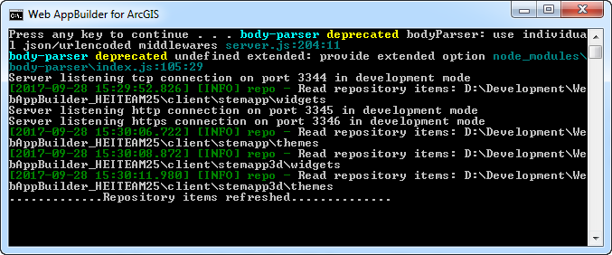
WAB – (Developer Edition) - Overview
Leverages ArcGIS API for JavaScript (same back end libraries)
Can add custom widgets and themes
Node.js

Slide 34


WAB Development – Technical Stuff Needed
HTML/JavaScript/CSS
DOJO Framework
JIMU (CSS styling)
Configuration in JSON

Slide 35
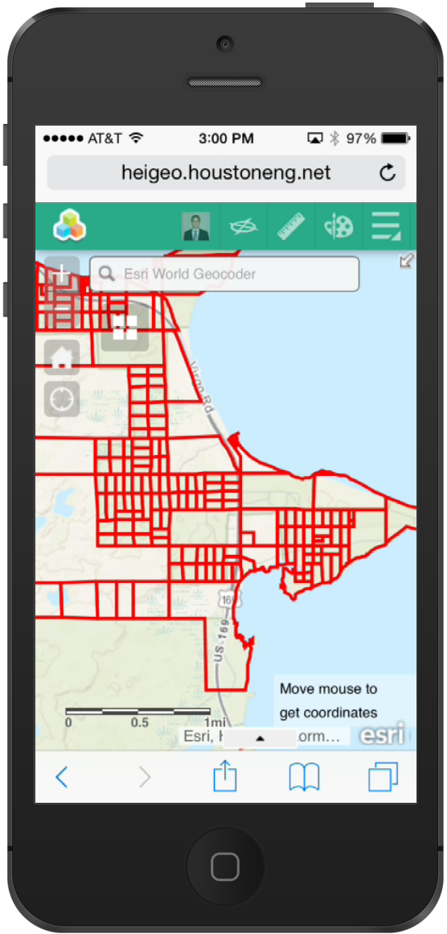
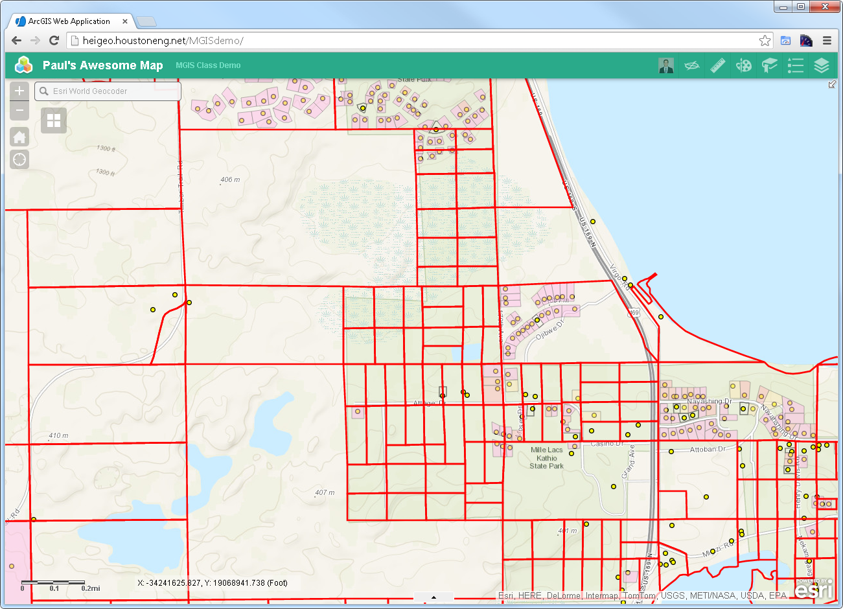
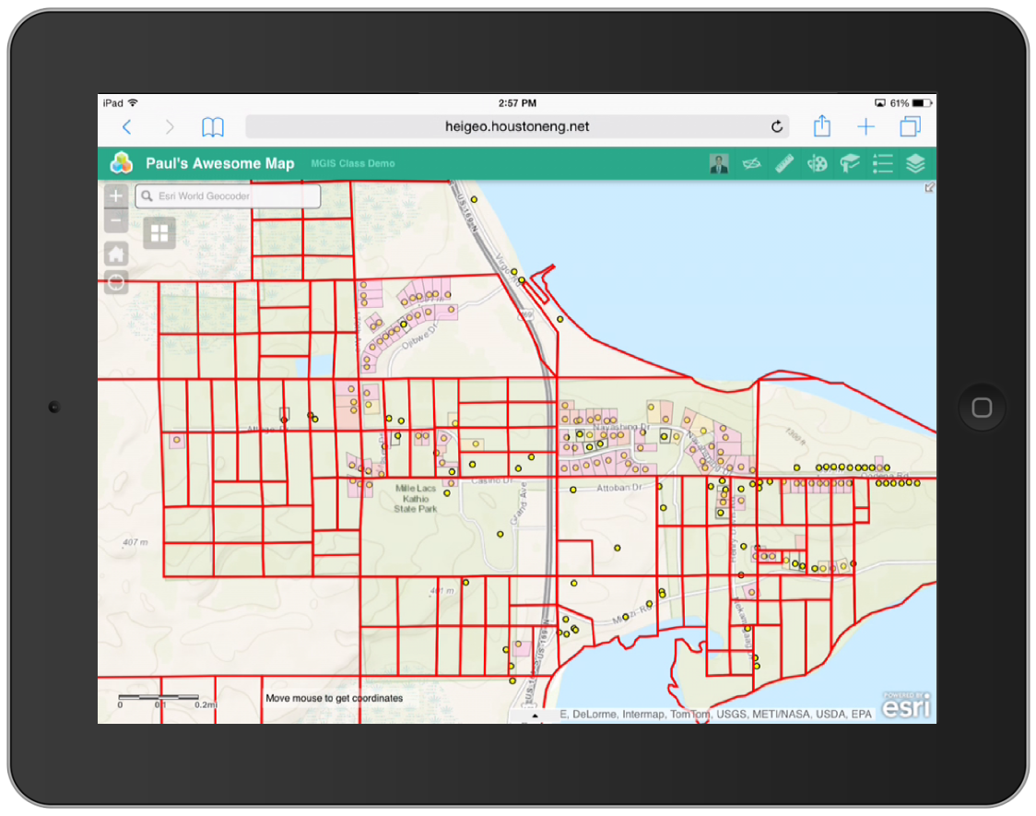
WAB – Responsive Design

Slide 36


WAB - Even works on this one

Slide 37

WAB - Not this one

Slide 38

WAB – Creating Custom Widgets

Slide 39
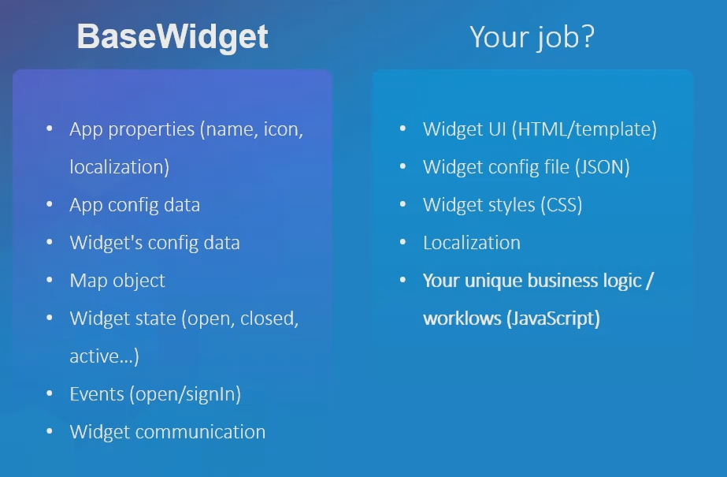
WAB – Extend Base Widget

Slide 40
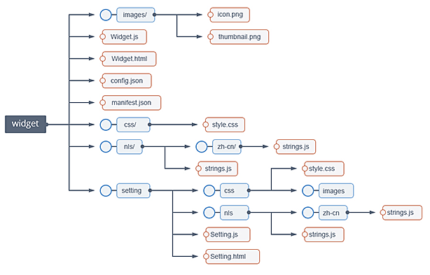
Custom Widget – File Structure
https://github.com/Esri/generator-esri-appbuilder-js

Slide 41
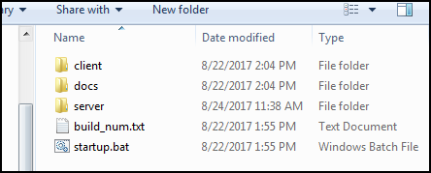
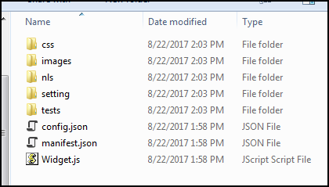
Widget Files …
WebAppBuilder\client\stemapp\widgets\{MyWidget}

Slide 42
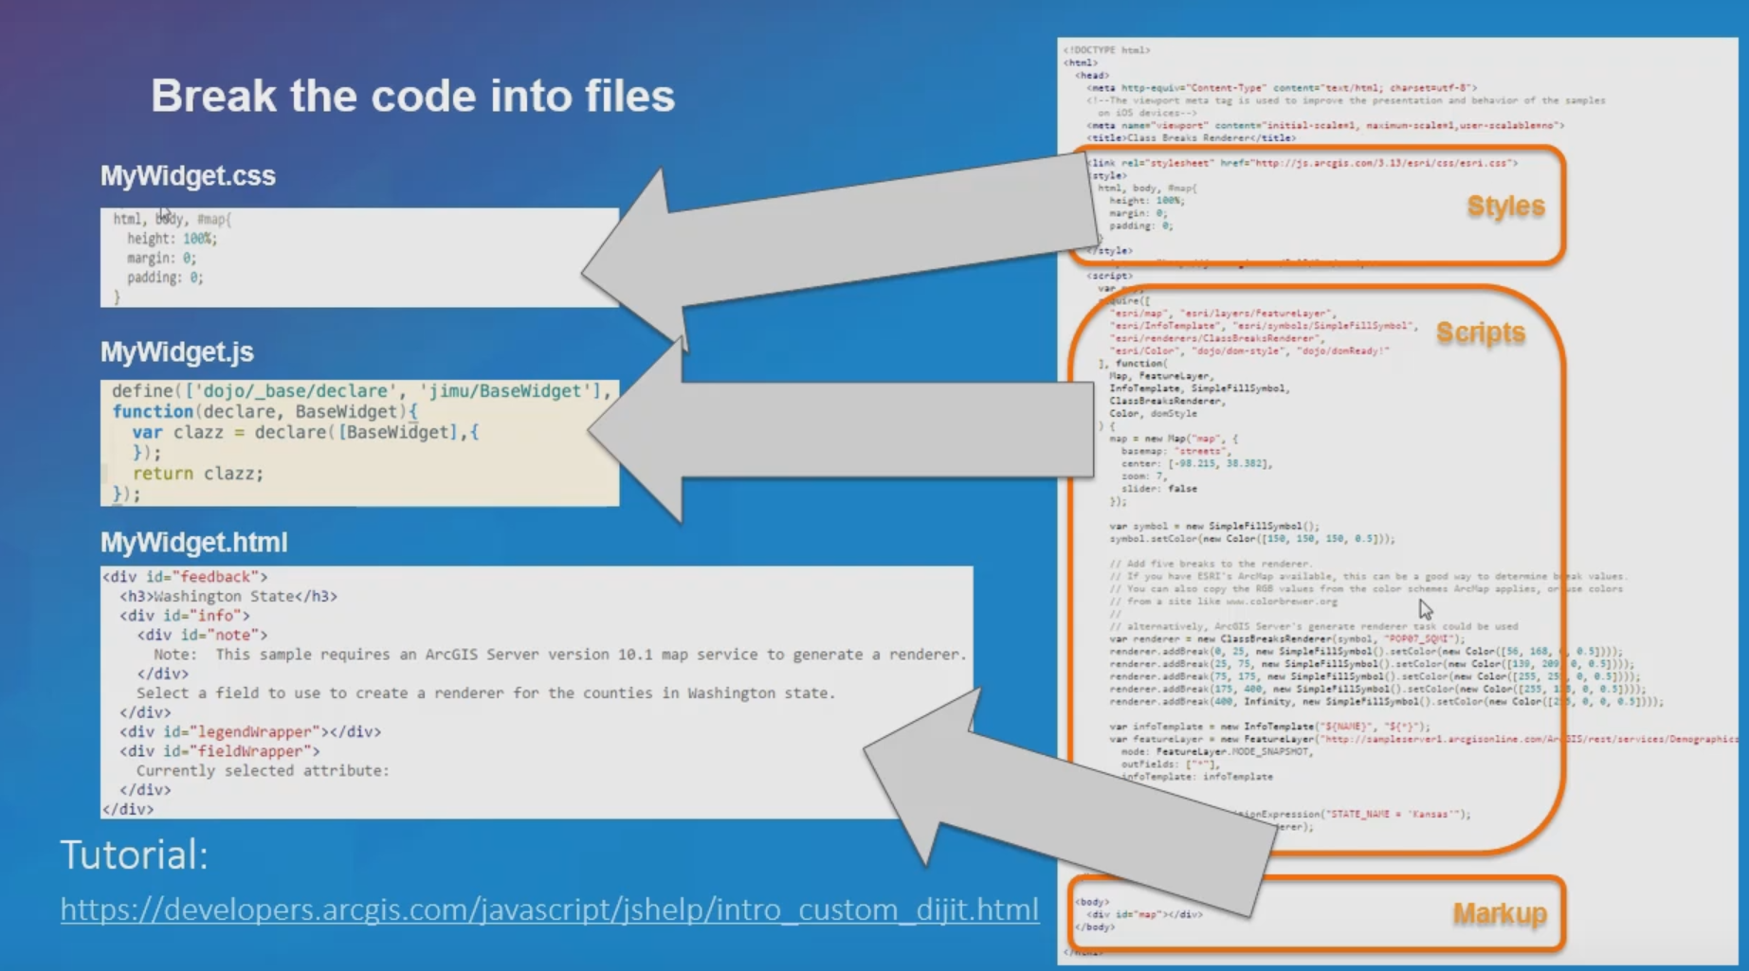
Custom Widget – File Structure

Slide 43

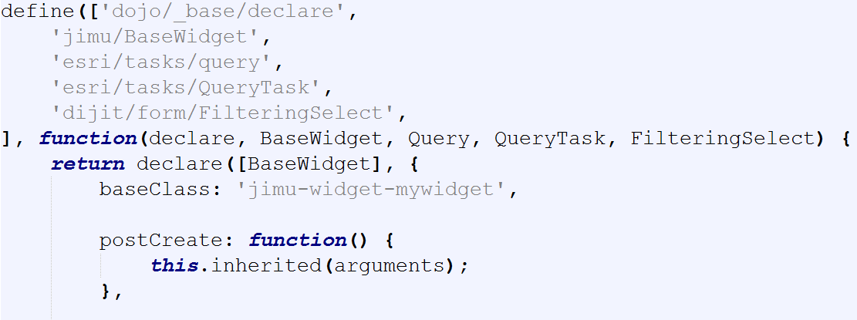
Custom Widget – Widget.js

Slide 44
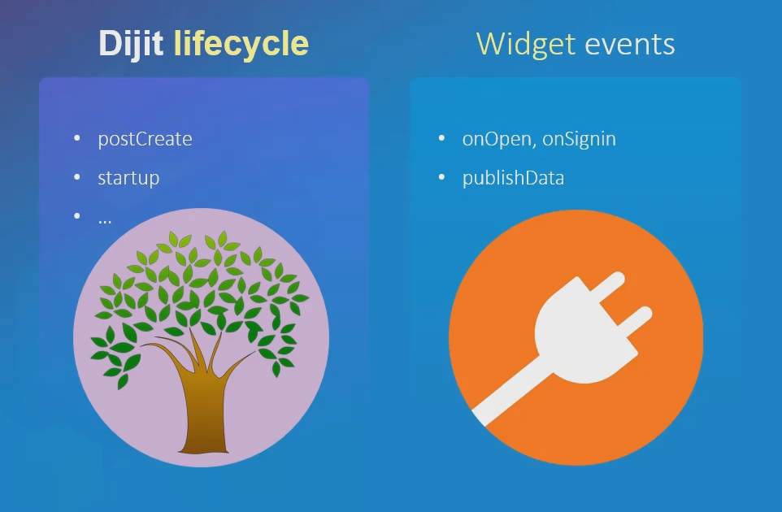
WAB – Extend Base Widget

Slide 45
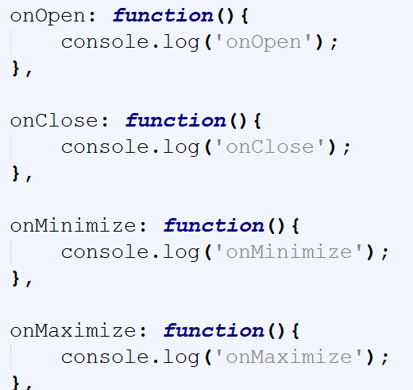
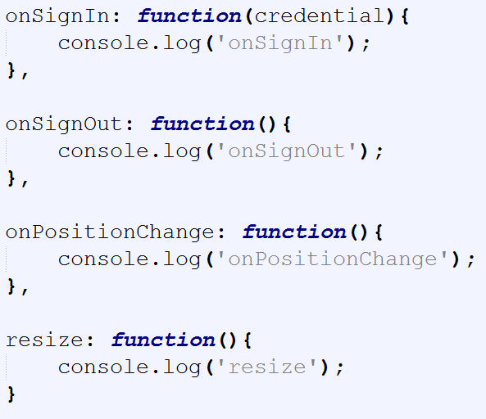
Custom Widget – Widget.js

Slide 46
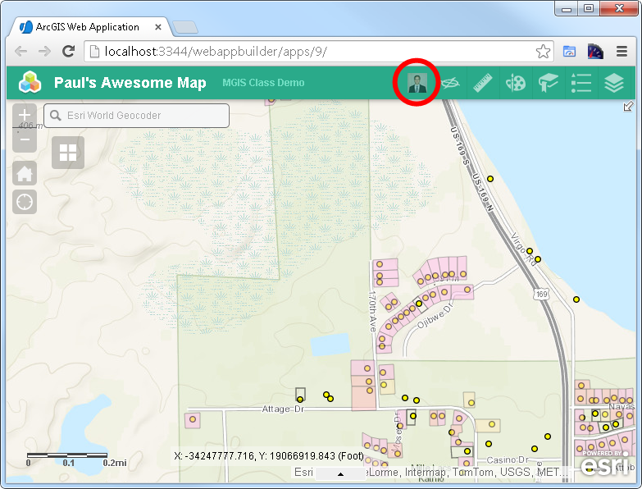
WAB – Custom Widget

Slide 47
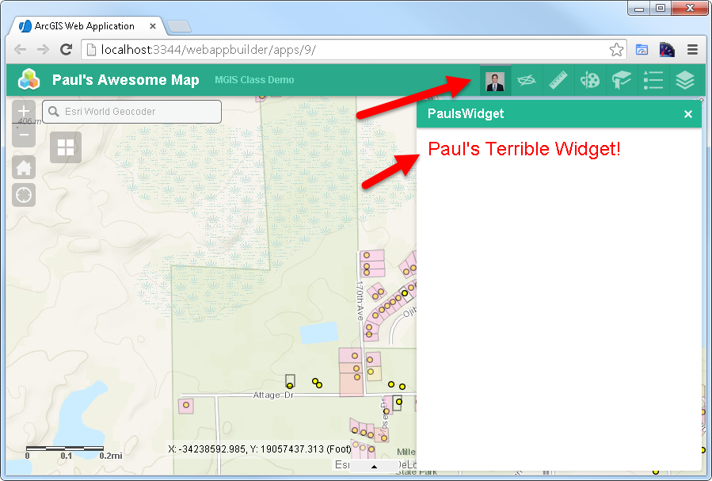
WAB – Custom Widget

Slide 48
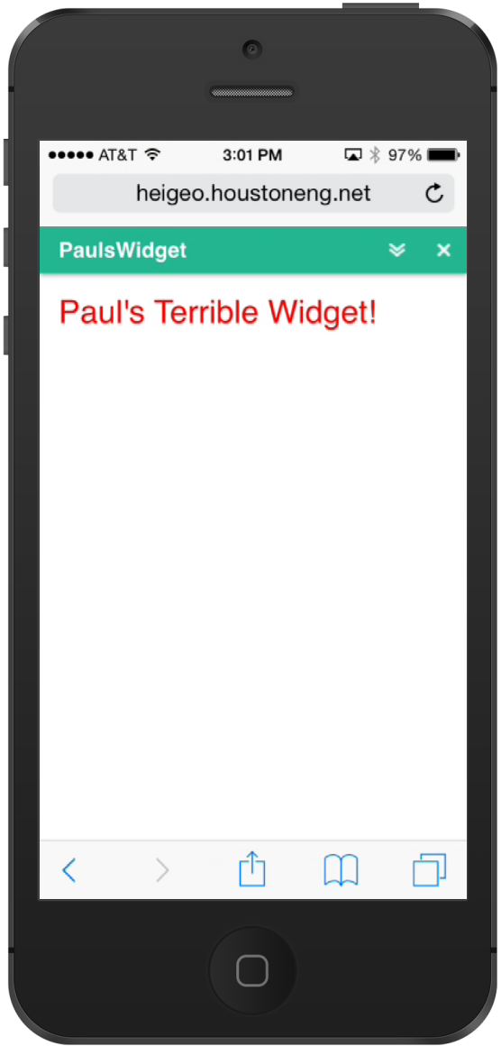
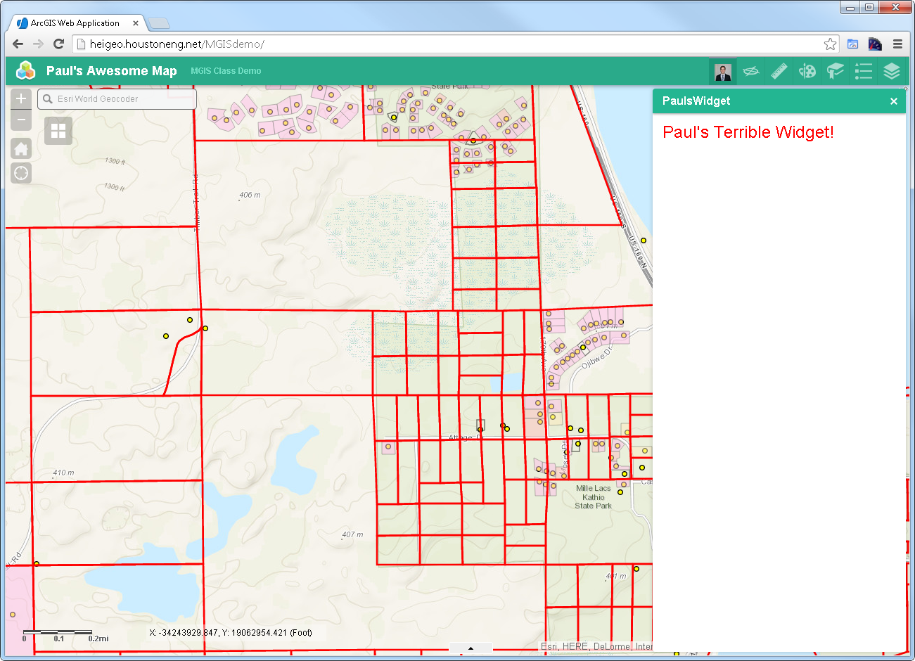
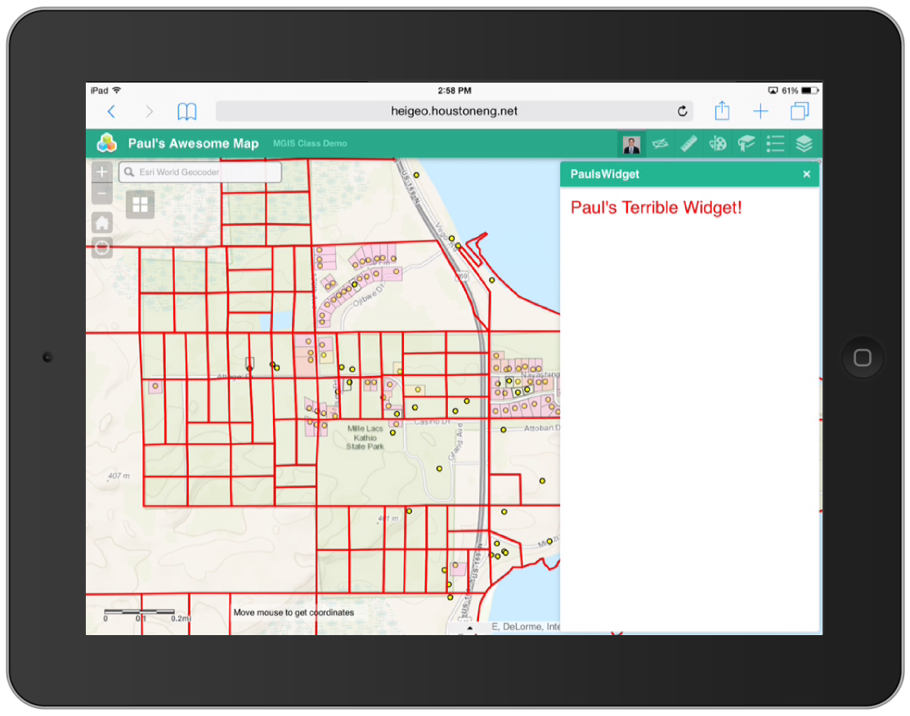
WAB – Responsive Custom Widget

Slide 49
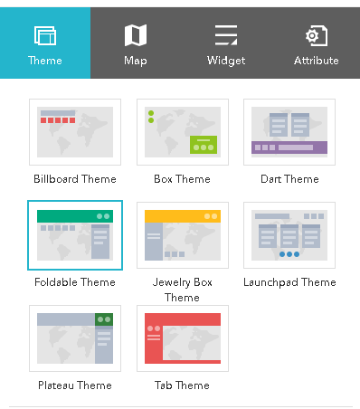
WAB – Themes

Slide 50
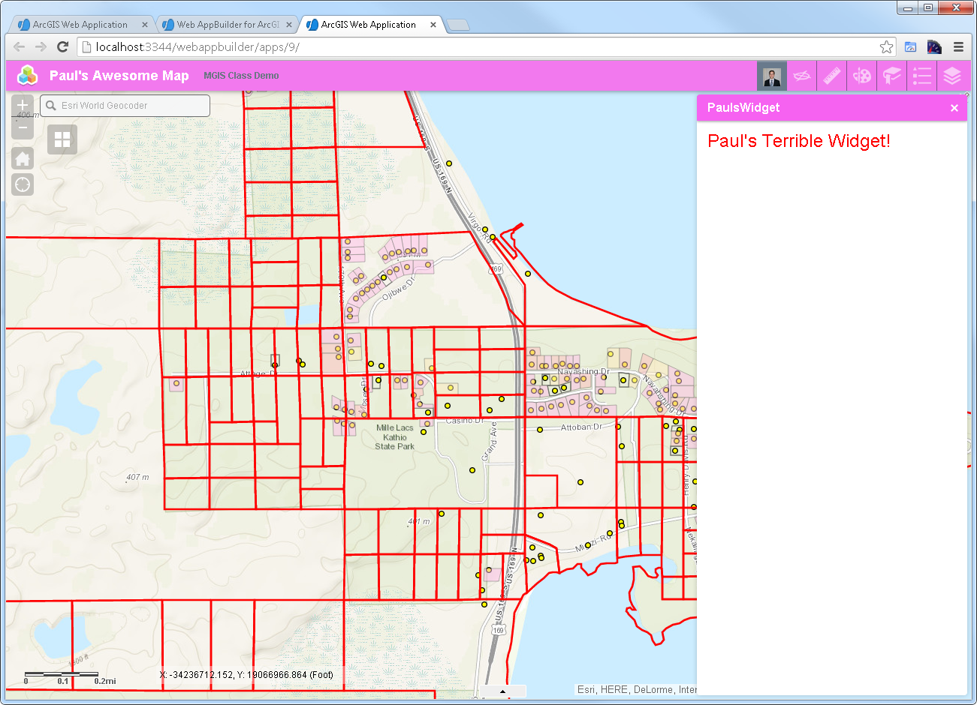
WAB – Themes (Modify Existing Theme)

Slide 51
Advanced Tools
Esri-wab-build (compressed build)
Yeoman Framework
Gulp/Grunt
TypeScript

Slide 52
WAB – Demos – What is Possible
https://egis.umn.edu/twincities/index.html
http://pm.maps.arcgis.com/apps/webappviewer/index.html?id=3eed8d6b30ea443dafe4380d70d0fa5e
http://top100projects.ca/map/
http://gisapp.mahoningcountyoh.gov/Mahgis/
https://whereto.sg/index.html
http://coolmaps.esri.com/dashboards/visionzero/
http://webappbuilderdemos.s3-website-us-east-1.amazonaws.com/waterfront/

Slide 53
Useful Links
GeoNet
https://geonet.esri.com/groups/web-app-builder-custom-widgets/content
https://geonet.esri.com/groups/web-appbuilder-custom-themes
Additional Widgets
https://geonet.esri.com/thread/119278-roberts-custom-wab-widgets
https://github.com/Esri/solutions-webappbuilder-widgets
https://github.com/Esri/WAB-Image-Services-Widgets
Other WAB Resources
https://geonet.esri.com/blogs/myAlaskaGIS/2016/03/09/web-appbuilder-developer-edition-customization-resource-list
https://github.com/gavinr/web-appbuilder-tools-techniques-dev-summit-2017

Slide 54
A few of the Widgets Developed By HEI
Go Anoka Park App – Advanced Custom Search and Custom Keyword Search
http://gis.anokacountymn.gov/GoAnoka/
Stearns County Park and Rec App - Advanced Custom Search and Custom Keyword Search
https://gis.co.stearns.mn.us/parks/index.html
Tracking Conservation Success – Custom Dashboard and Edit Widget
http://tcs.houstoneng.net/wi/
Considated Irrigation District – Custom Well Water Levels Charting
http://cid.houstoneng.net/ (username and password required)
Others
Mailing Labels Widget
Custom Display Widget for Print (Isolate Widget)
Custom Selection Widget
More

Slide 55

Custom Widget – Time to Code…
https://github.com/paulhedlund/2017GISLIS

Slide 56
Thanks for Attending! Questions?

